Slide 1
Software Construction and Development
Week 9
Instructor :M Khizar Hayat
Chapters 23, Code Complete
Chapter 7, Clean Code

Slide 2
Event Handling
Event Handling is fundamental to java programming because it is used to create event driven programs e.g GUI based windows applications, Web Application etc.
Event handling mechanism have been chaged significantly between the original version of Java(1.0) and all subsequent versions of Java, beginning with version 1.1.
The modern approach of handling events is based on the delegation event model.

Slide 3
What is an Event?
Change in the state of an object is known as event i.e event describes the change in state of source
Events are generated as result of user interaction with the graphical user interface components
For example, clicking on a button, moving the mouse, entering a character through keyboard, selecting an item from list, scrolling the page are the activities that causes an event to happen

Slide 4
Types of Event
The events can be broadly classified into two categories:
Foreground Events - Those events which require the direct interaction of user
They are generated as consequences of a person interacting with the graphical components in Graphical User Interface
For example, clicking on a button, moving the mouse, entering a character through keyboard, selecting an item from list, scrolling the page etc
Background Events - Those events that don’t require interactions of user to generate
For example, operating system interrupts, hardware or software failure, timer expires, an operation completion etc

Slide 5
What is an Event Handling?
Event Handling is the mechanism that controls the event and decides what should happen if an event occurs
This mechanism have the code which is known as event handler that is executed when an event occurs
Java uses the Delegation Event Model to handle the events
This model defines the standard mechanism to generate and handle the events. Let’s have a brief introduction to this model

Slide 6
Source & Listener
The Delegation Event Model has the following key participants namely:
Source - The source is an object on which event occurs
Source is responsible for providing information of the occurred event to it’s handler. Java provides classes for source object
Listener - It is also known as event handler
Listener is responsible for generating response to an event. From java implementation point of view the listener is also an object.Listener waits until it receives an event. Once the event is received, the listener process the event and then returns

Slide 7
Source & Listener
Its concept is quite simple: a source generates an event and sends it to one or more listeners. In this scheme, the listener simply waits until it receives an event
Once an event is received, the listener processes the event and then returns
This provides an example benefit: notifications are sent only to listeners that want to receive them
To perform Event Handling, we need to register the source with the listener

Slide 8
Registering Listener
A source must register listeners in order for the listeners to receive notifications about a specific type of event. Each type of event has its own registration method. Here is the general form:
public void addTypeListener (TypeListener el)
Type is the name of the event , and el is the refernce to the event listener
For example, the method that registers a keyboard event listener is called addKeyListener( ). The method that registers a mouse event listener is called addMouseMotionListener( )

Slide 9
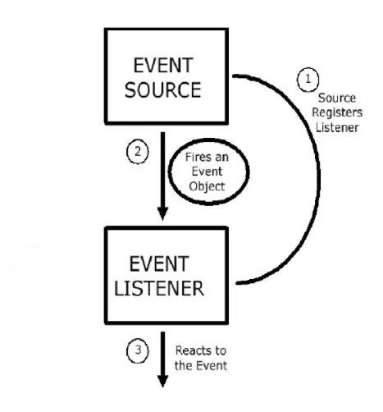
Delegation Event Model

Slide 10
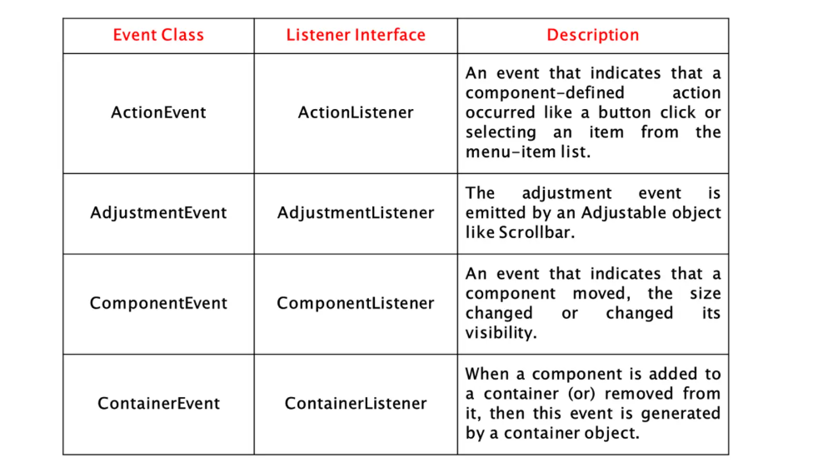
Event Classes in Java

Slide 11
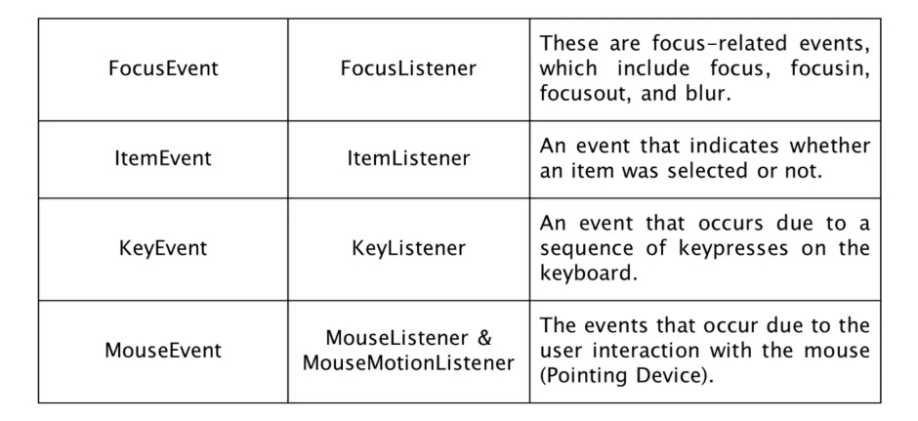
Event Classes in Java

Slide 12
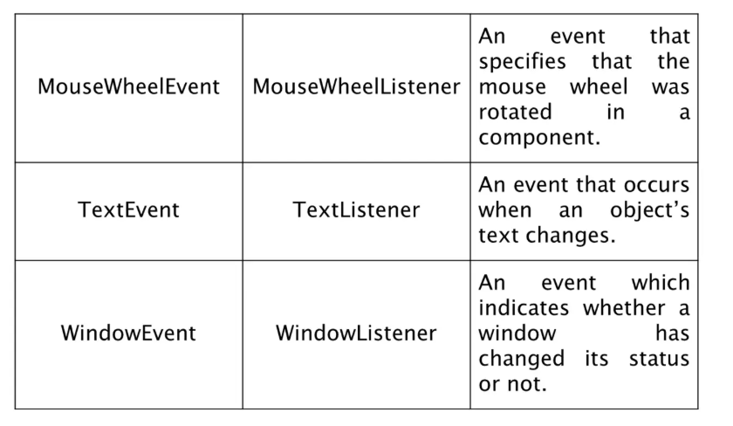
Event Classes in Java

Slide 13
Event Listener Interfaces
As explained, the delegation event model has two parts: sources and listeners
Listeners are created by implementing one or more of the interfaces defined by the java.awt.event package
When an event occurs, the event source invokes the appropriate method defined by the listener and provides an event object as its argument

Slide 14
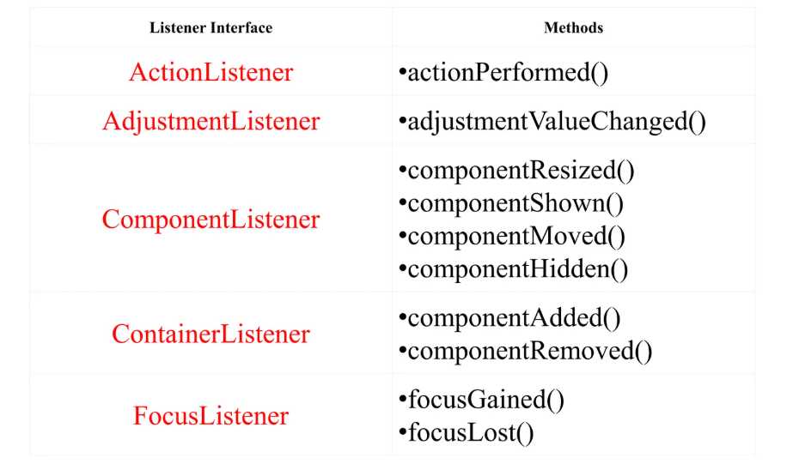
Event Listener Interfaces

Slide 15
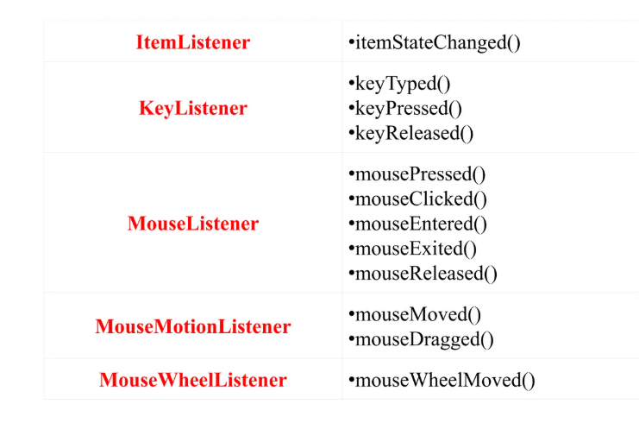
Event Listener Interfaces

Slide 16
Java MouseListener Interface
The Java MouseListener Interface is notified whenever you change the state of mouse. It is notified against MouseEvent
The MouseListener interface is found in java.awt.event package. It has five methods

Slide 17
Methods of MouseListener Interface
The signature of 5 methods found in MouseListener interface are given below:
public abstract void mouseClicked(MouseEvent e);
public abstract void mouseEntered(MouseEvent e);
public abstract void mouseExited(MouseEvent e);
public abstract void mousePressed(MouseEvent e);
public abstract void mouseReleased(MouseEvent e);

Slide 18
MouseListener Sample Code
import java.awt.*;
import java.awt.event.*;
public class MouseListenerExample extends Frame implements
MouseListener{
Label l;
MouseListenerExample(){
addMouseListener(this);
l=new Label();
l.setBounds(20,50,100,20);
add(l);
setSize(300,300);
setVisible(true);
}

Slide 19
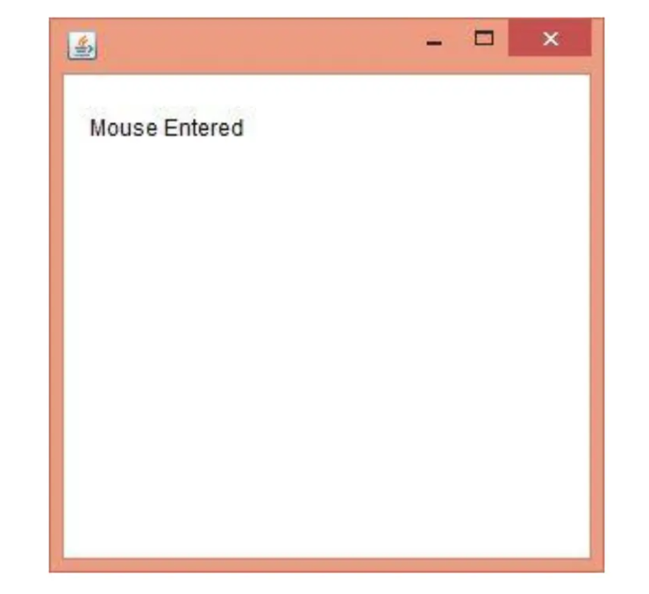
public void mouseClicked(MouseEvent e) {
l.setText(“Mouse clicked!”);
}
public void mouseEntered(MouseEvent e) {
l.setText(“Mouse entered!”);
}
public void mouseExited(MouseEvent e) {
l.setText(“Mouse exited!”);
}
public void mousePressed(MouseEvent e) {
l.setText(“Mouse pressed!”);
}
public void mouseReleased(MouseEvent e) {
l.setText(“Mouse released!”);
}
public static void main (String[] args) {
new MouseListenerExample();
}
}

Slide 20
Java KeyListener Interface
The Java KeyListener is notified whenever you change the state of key
It is notified against KeyEvent. The KeyListener interface is found in java.awt.event package, and it has three methods

Slide 21
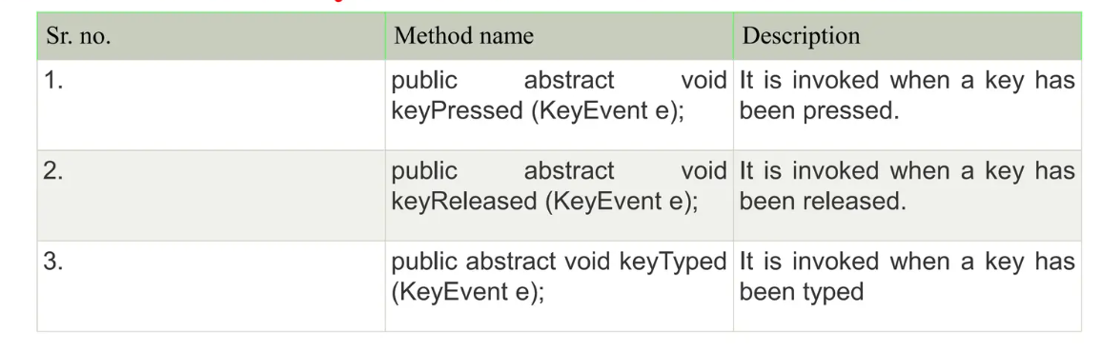
Interface Declaration
Following is the declaration
for java.awt.event.KeyListener interface:
public interface KeyListener extends EventListener

Slide 22
Thank You!

